Slide 1
SQL
Data Cleaning

Slide 2
Agenda
Introduction
Building confidence
Engaging the audience
Visual aids
Final tips & takeaways

Slide 3
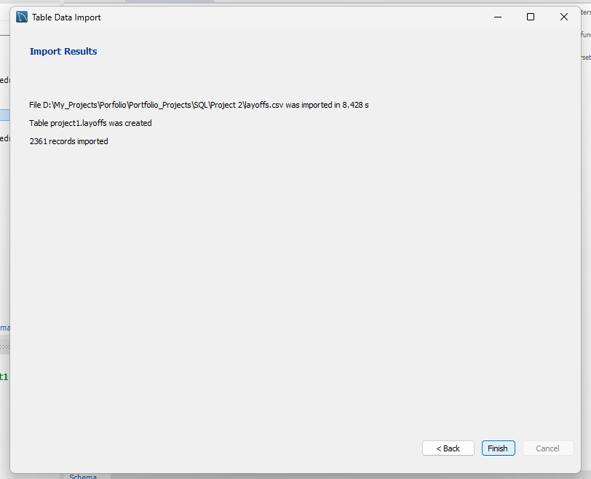
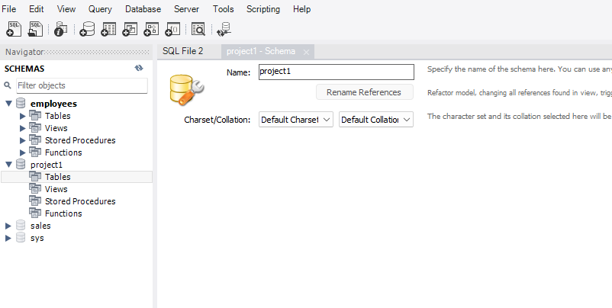
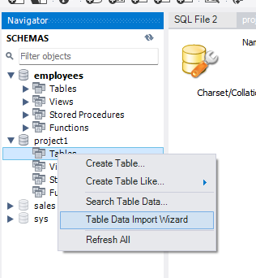
Successfully imported
Creating a new schema
Importing data set into tables

Slide 4

Power of communication

Slide 5

Overcoming nervousness
Confidence-building strategies

Slide 6
Engaging the audience
Make eye contact with your audience to create a sense of intimacy and involvement
Weave relatable stories into your presentation using narratives that make your message memorable and impactful
Encourage questions and provide thoughtful responses to enhance audience participation
Use live polls or surveys to gather audience opinions, promoting engagement and making sure the audience feel involved

Slide 7
Selecting visual aids
Enhancing your presentation

Slide 8
Effective delivery techniques
This is a powerful tool in public speaking. It involves varying pitch, tone, and volume to convey emotion, emphasize points, and maintain interest:
  Pitch variation
  Tone inflection
  Volume control
Effective body language enhances your message, making it more impactful and memorable:
  Meaningful eye contact
  Purposeful gestures
  Maintain good posture
  Control your expressions

Slide 9
Navigating Q&A sessions
Know your material in advance
Anticipate common questions
Rehearse your responses
Maintaining composure during the Q&A session is essential for projecting confidence and authority. Consider the following tips for staying composed:
  Stay calm
  Actively listen
  Pause and reflect
  Maintain eye contact

Slide 10

Speaking impact
Your ability to communicate effectively will leave a lasting impact on your audience
Effectively communicating involves not only delivering a message but also resonating with the experiences, values, and emotions of those listening

Slide 11
Dynamic delivery
Learn to infuse energy into your delivery to leave a lasting impression.
One of the goals of effective communication is to motivate your audience.
Metric | Measurement | Target | Actual
Audience attendance | # of attendees | 150 | 120
Engagement duration | Minutes | 60 | 75
Q&A interaction | # of questions | 10 | 15
Positive feedback | Percentage (%) | 90 | 95
Rate of information retention | Percentage (%) | 80 | 85

Slide 12
Final tips & takeaways
Consistent rehearsal
  Strengthen your familiarity
Refine delivery style
  Pacing, tone, and emphasis
Timing and transitions
  Aim for seamless, professional delivery
Practice audience
  Enlist colleagues to listen & provide feedback
Seek feedback
Reflect on performance
Explore new techniques
Set personal goals
Iterate and adapt

Slide 13
Speaking engagement metrics
Impact factor | Measurement | Target | Achieved
Audience interaction | Percentage (%) | 85 | 88
Knowledge retention | Percentage (%) | 75 | 80
Post-presentation surveys | Average rating | 4.2 | 4.5
Referral rate | Percentage (%) | 10 | 12
Collaboration opportunities | # of opportunities | 8 | 10

Slide 14
Thank you
Brita Tamm
502-555-0152
brita@firstupconsultants.com
www.firstupconsultants.com

